Slide 1

7th Grade Math
Unit 6, Lesson 3 Converting Units of Length Volume 1, pg. 245

Slide 2


Benchmark
MA.7.AR.3.3
Solve mathematical and real-world problems involving the conversion of units across different measurement systems.
volume 1, pg. 245

Slide 3
Integrated Mathematical Thinking and Reasoning Standards
MA.K12.MTR.3.1 Complete tasks with mathematical fluency.
volume 1, pg. 245

Slide 4

Learning Target
I can convert length measurements across different measurement systems.
volume 1, pg. 245

Slide 5

Warm-Up
volume 1, pg. 246

Slide 6
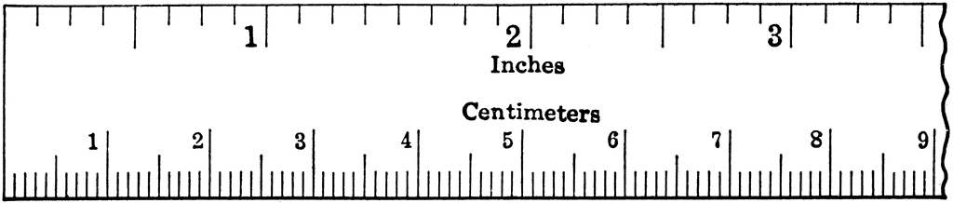
6.3.1 Warm-Up: A Closer Look at Rulers
A screenshot of a ruler that shows inches (in.) and centimeters (cm) is shown. The image is not to scale.
Look closely at the markings and labels on the ruler.
volume 1, pg. 246

Slide 7
Write three observations about the markings and measurements on the ruler.
Compare observations with your partner. Add any additional observations your partner made to your list above.
volume 1, pg. 246

Slide 8

Activity
volume 1, pg. 246

Slide 9

6.3.2 Activity: Measuring Objects to Determine Conversion Rates
With your partner, choose three classroom objects that can be measured with a standard ruler. Measure each object’s length in inches (in.) and in centimeters (cm). Use the measurements to complete the table, being as precise as possible.
Object | Length in Inches (in.) | Length in Centimeters (cm)
volume 1, pg. 246

Slide 10
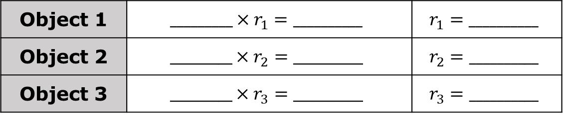
Similar to using exchange rates to convert currencies, you can use conversion rates to convert measurements.
To convert the length from inches (in.) to centimeters (cm), multiply the length in inches by a conversion rate. The result is the length in centimeters.
Use the two measurements for each object you measured to estimate a conversion rate for converting inches to centimeters.
Object 1 | $$_________×r_{1}=__________$$ | $$r_{1}=__________$$
Object 2 | $$_________×r_{2}=__________$$ | $$r_{2}=__________$$
Object 3 | $$_________×r_{3}=__________$$ | $$r_{3}=__________$$
volume 1, pg. 246

Slide 11
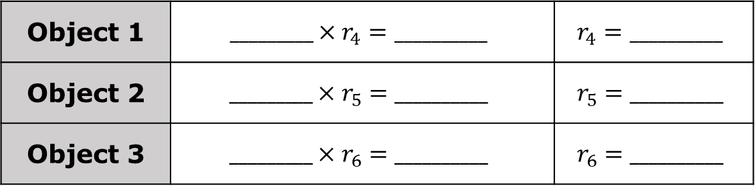
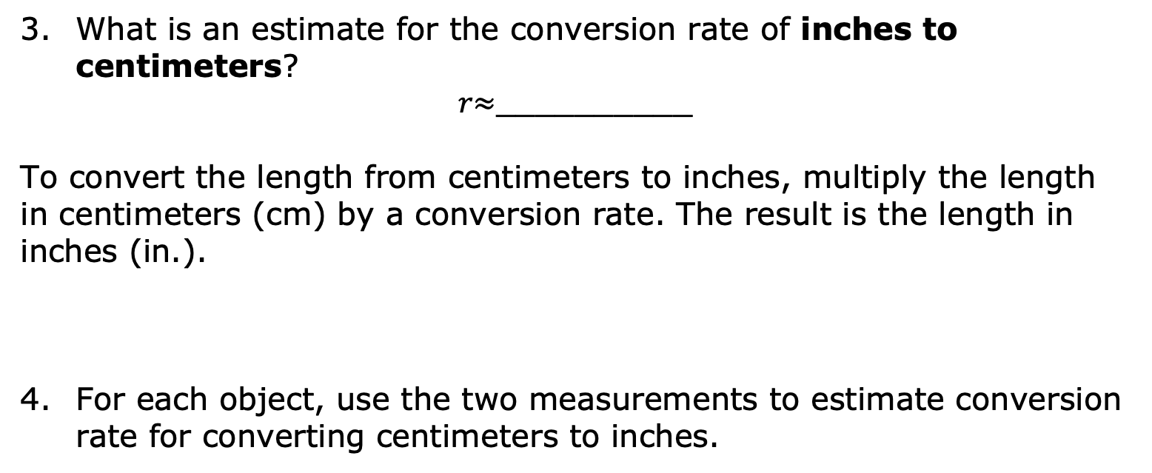
What is an estimate for the conversion rate of inches to centimeters?
𝑟$≈$__________
To convert the length from centimeters to inches, multiply the length in centimeters (cm) by a conversion rate. The result is the length in inches (in.).
For each object, use the two measurements to estimate conversion rate for converting centimeters to inches.
Object 1 | $$_________×r_{4}=__________$$ | $$r_{4}=__________$$
Object 2 | $$_________×r_{5}=__________$$ | $$r_{5}=__________$$
Object 3 | $$_________×r_{6}=__________$$ | $$r_{6}=__________$$
volume 1, pg. 247

Slide 12
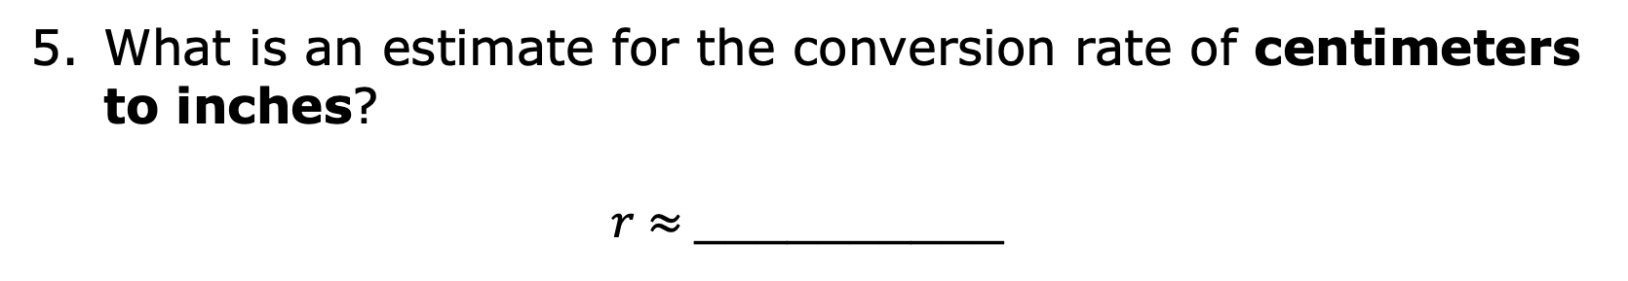
What is an estimate for the conversion rate of centimeters to inches?
𝑟 $≈$__________
volume 1, pg. 247

Slide 13

Bring It Together
volume 1, pg. 247

Slide 14


6.3.3 Bring It Together: Measurement Systems
Inches (in.) are a common unit for measuring length in the U.S. customary system, while centimeters (cm) are a common unit for measuring length in the metric system.
Did you know?
Most countries use the metric system of measurement. In fact, only three countries still use the customary system – the United States, Liberia, and Myanmar.
Conversion tables are a useful tool for converting one measurement system to another.
volume 1, pg. 247

Slide 15

Guided Practice
volume 1, pg. 248

Slide 16

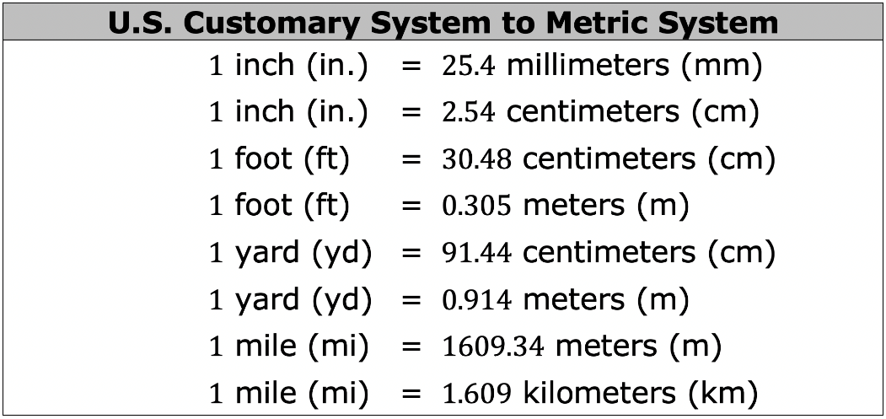
6.3.4 Guided Practice: Using Conversion Tables
The tables below show the conversion rates for common units of length in the US Customary and Metric systems.
volume 1, pg. 248

Slide 17
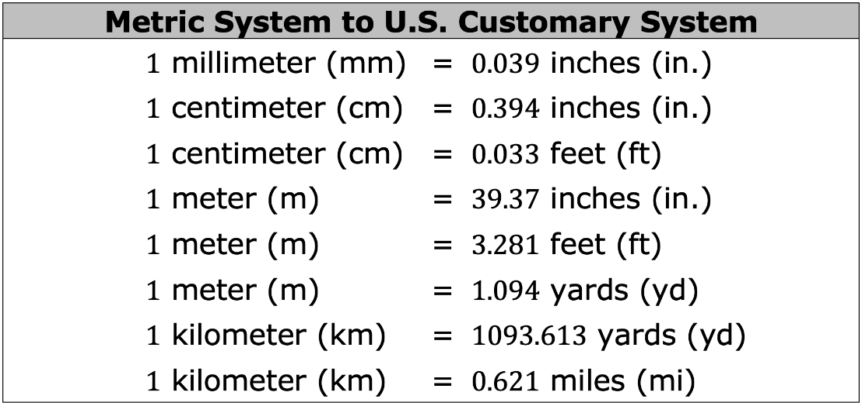
Complete the statements below using the information from the conversion tables.
To convert feet to centimeters, multiply the number of feet by _______ to find the equivalent number of centimeters.
volume 1, pg. 248

Slide 18
To convert centimeters to feet, multiply the number of centimeters by _____ to find the equivalent number of feet.
To convert meters to yards, multiply the number of meters by _______ to find the equivalent number of yards.
To convert yards to meters, multiply the number of yards by _______ to find the equivalent number of meters.
volume 1, pg. 248

Slide 19

Use the conversion rates to convert each measurement length.
$30$ miles = ______ kilometers
$65$ kilometers = ______ miles
$10$ inches = ______ millimeters
$450$ millimeters = ______ inches
volume 1, pg. 248

Slide 20

Collaboration
volume 1, pg. 249

Slide 21

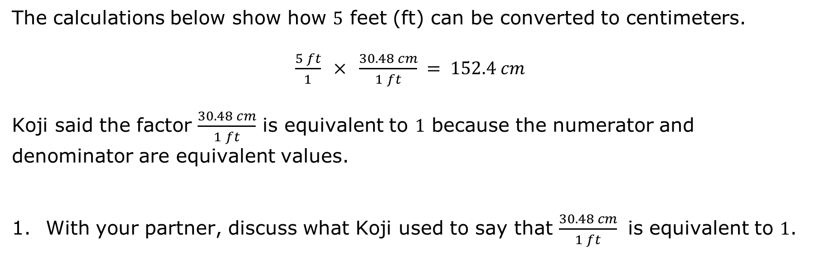
6.3.5 Collaboration: Digging Deeper into Conversion Rates
The calculations below show how $5$ feet (ft) can be converted to centimeters.
$\frac{5 ft}{1} × \frac{30.48 cm}{1 ft} = 152.4 cm$
Koji said the factor $\frac{30.48 cm}{1 ft}$ is equivalent to $1$ because the numerator and denominator are equivalent values.
With your partner, discuss what Koji used to say that $\frac{30.48 cm}{1 ft}$ is equivalent to $1$.
volume 1, pg. 249

Slide 22

Explain how this shows $5$ ft is equal to $152.4$ cm.
Eva noticed that in the calculation of the conversion, the unit feet (ft) was in the numerator and the denominator. How does this eliminate the units of feet in the calculation?
volume 1, pg. 249

Slide 23
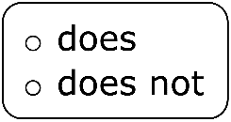




Complete the statements below.
When multiplying a measurement by a conversion factor, the
value of the measurement change because the
conversion factor is equivalent to $1$. The units
change because when the same units appear in the numerator
and denominator, it is similar to having the same value in the
numerator and denominator, so these units become $1$.
Multiplicative Identity Property of One
$a×1=a$ or $1×a=a$
volume 1, pg. 249

Slide 24

Try It
volume 1, pg. 250

Slide 25

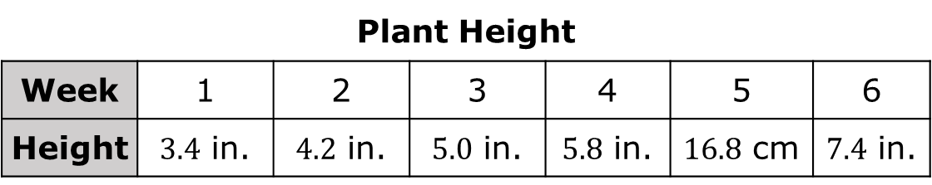
6.3.6 Try It: Converting Lengths to Solve Problems
Raphael measures the height of a plant each week using an inch (in.) ruler. On week 5, he cannot find the inch ruler, so he uses a centimeter (cm) ruler instead. His measurements are shown.
Plant Height
Week | 1 | 2 | 3 | 4 | 5 | 6
Height | $3.4$ in. | $4.2$ in. | $5.0$ in. | $5.8$ in. | $16.8$ cm | $7.4$ in.
How much taller, in inches, is the plant in week $5$ than in week $4$?
volume 1, pg. 250

Slide 26

Your Turn
volume 1, pg. 250

Slide 27

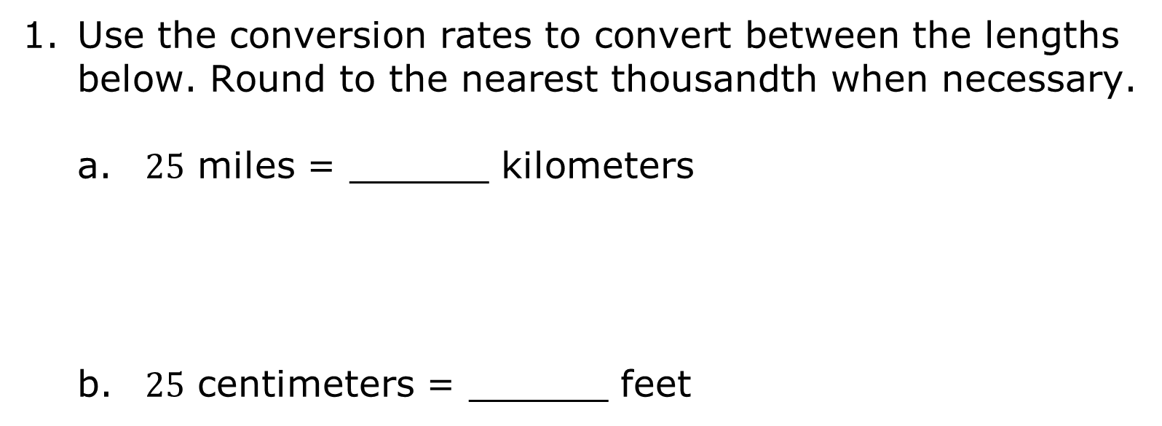
6.3.7 Your Turn!
Use the conversion rates to convert between the lengths below. Round to the nearest thousandth when necessary.
$25$ miles = ______ kilometers
$25$ centimeters = ______ feet
volume 1, pg. 250

Slide 28

$3$ yards = ______ meters
$470$ millimeters = ______ inches
Maya visits her friend in Europe and rides in an electric car. The electric vehicle can travel $200$ kilometers (km) on one charge. If their destination is $130$ miles (mi) away, will they be able to make it there without having to stop to charge the car? Explain or show work to justify your answer.
volume 1, pg. 250

Slide 29

Wrap-Up
volume 1, pg. 251

Slide 30
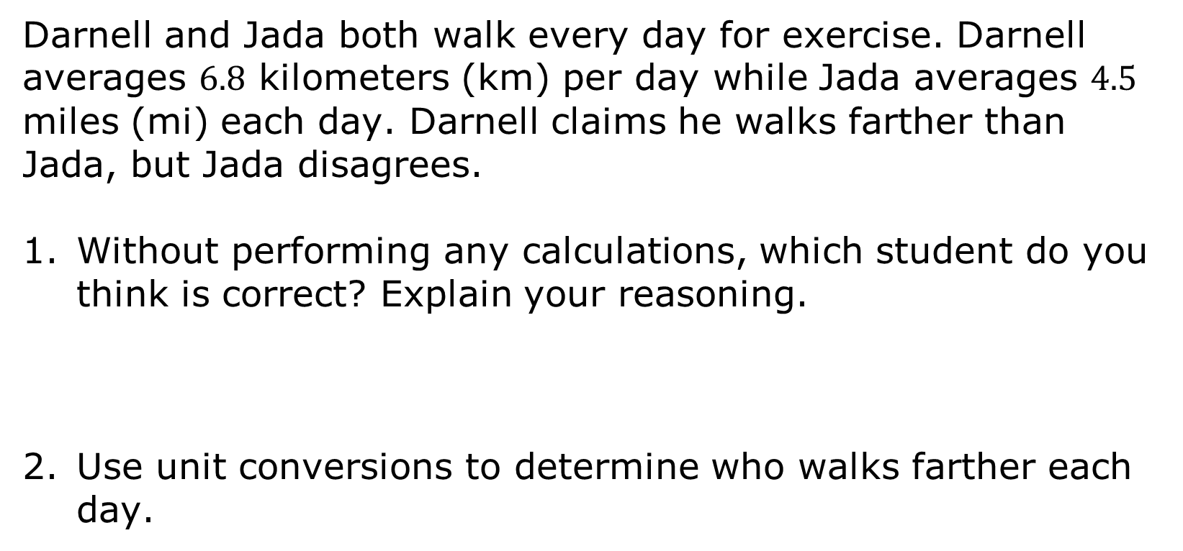
6.3.8 Wrap-Up: Ticket Out the Door
Darnell and Jada both walk every day for exercise. Darnell averages $6.8$ kilometers (km) per day while Jada averages $4.5$ miles (mi) each day. Darnell claims he walks farther than Jada, but Jada disagrees.
Without performing any calculations, which student do you think is correct? Explain your reasoning.
Use unit conversions to determine who walks farther each day.
volume 1, pg. 251

